Slide 1

A Quantum Approach for Classifying Contaminant Ions in Water
Rudraksh Sharma | November 16, 2025
Rudraksh

Slide 2

The Challenge
The Problem
Why Quantum?
Classify four contaminant ion types (C0, C1, C2, C3) in water using photonic sensor data with three continuous parameters: wavelength, propagation constant, and electric field fraction.
Complex, non-linear correlations in sensor data make this ideal for Quantum Machine Learning, leveraging high-dimensional Hilbert spaces for effective decision boundaries.
Rudraksh

Slide 3



Hybrid Quantum-Classical Architecture
Classical Encoder
Quantum Circuit
Classical Head
Trainable feature extractor maps 3 input features to latent space (48-64 dimensions)
Variational quantum circuit processes state using StronglyEntanglingLayers ansatz
Final neural network performs 4-class classification from quantum measurements
Rudraksh

Slide 4

Three Model Variants
v6_2 Model
v7_3 Model
6 qubits with 2 layers of ansatz
7 qubits with 3 layers of ansatz
v8_3 Model
8 qubits with 3 layers of ansatz
Systematic increase in quantum resources to find optimal configuration across 48,000 training samples.
Rudraksh

Slide 5

Learnable Data-Driven Encoding
The Challenge
Encoding 3 features onto 6+ qubits requires a smart strategy beyond naive fixed encoding.
The Solution
Classical encoder learns optimal representation in Nq-dimensional latent space, then transforms to rotation parameters:
Rudraksh
The tanh function bounds angles to (-π, π), preventing parameter saturation and ensuring stable gradients.

Slide 6


Two-Stage Training Strategy
Full Hybrid Training
Encoder Pretraining
Complete model trained for up to 20 epochs using Focal Loss (γ=1.5) with lower learning rate (LR=5e-4).
Classical encoder trained for 8 epochs with CrossEntropyLoss and Adam optimizer (LR=1e-3) to initialize weights.
3-Fold Cross-Validation
Class Weights
Stratified CV ensures representative validation sets and robust out-of-fold predictions for ensembling.
Manual weights [1.0, 1.0, 1.0, 1.2] give 20% higher penalty for misclassifying challenging ion C3.
Rudraksh

Slide 7
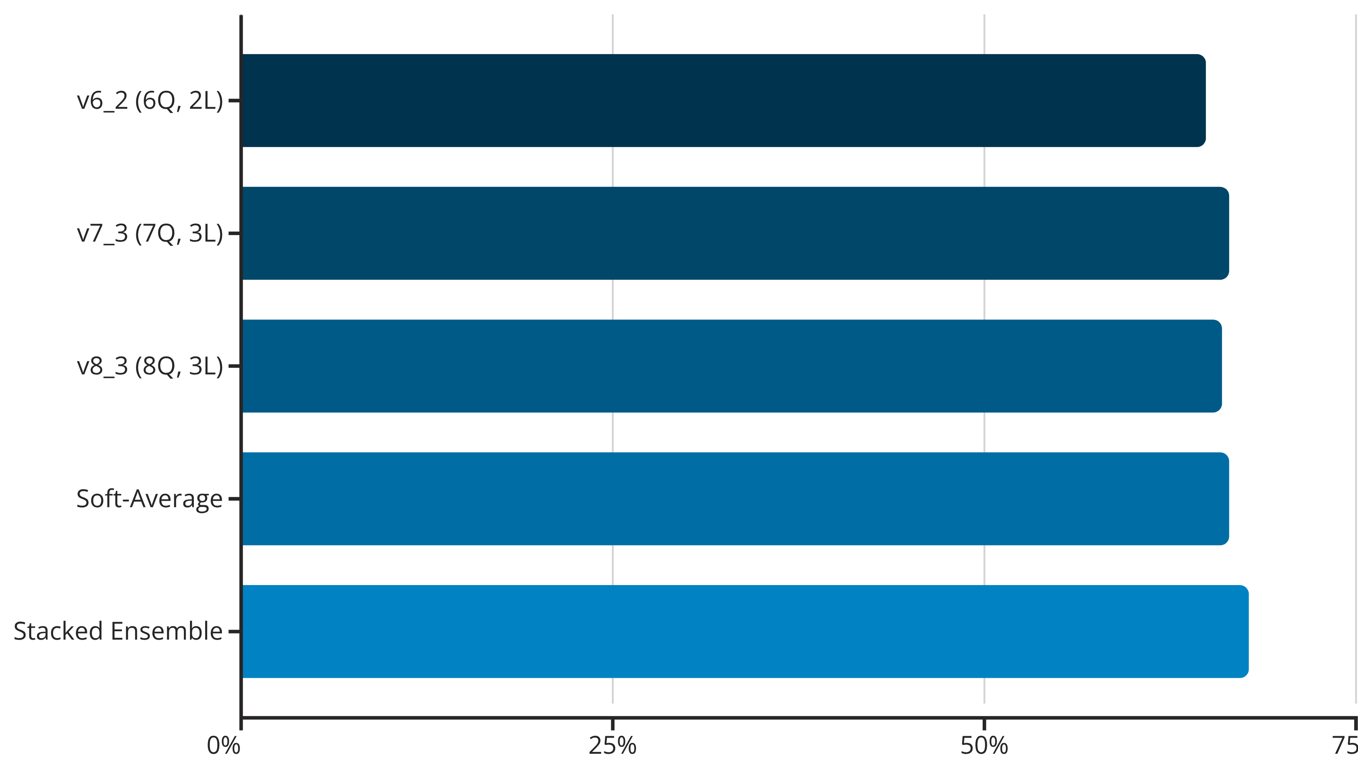
Ensemble Performance
Rudraksh
The stacked ensemble uses LogisticRegression to optimally combine predictions from all three quantum model variants, achieving the highest performance.

Slide 8




Per-Class Performance Analysis
Ion C2: Exceptional
Ion C1: Strong
F1-score: 98%
F1-score: 73%
Precision: 97.7% | Recall: 98.2%
Precision: 60.4% | Recall: 91.8%
Ion C0: Weak
Ion C3: Challenging
F1-score: 50%
F1-score: 44%
Precision: 59.7% | Recall: 42.7%
Precision: 50.5% | Recall: 38.3%
Overall weighted accuracy: 67.76% across 48,000 samples. Primary weakness: C0 and C3 confusion due to similar optical responses.
Rudraksh

Slide 9

Key Limitations
Class Confusion
Ansatz Trainability
Poor separability between C0 and C3 ions. Large numbers of true C0 samples misclassified as C3 and vice-versa, suggesting fundamental limits in sensor data.
StronglyEntanglingLayers are highly expressive but susceptible to barren plateaus, especially with increased qubits and layers.
Computational Cost
Training VQCs is intensive. 3-fold CV on 3 model variants with pretraining represents significant computational investment.
Rudraksh

Slide 10




Future Improvements
Quantum Kernel Methods
Data Re-uploading
Use VQC architecture as trainable kernel paired with classical SVM for better decision boundaries in low-dimensional input space.
Re-upload 3 input features multiple times between ansatz layers to increase expressivity without adding qubits.
Feature Engineering
Custom Ansatz Design
Create polynomial terms and ratios from original features to help encoder find more separable latent representations for C0/C3.
Explore problem-specific or hardware-efficient ansatze that may be easier to train for this data structure.
Rudraksh

